Slide 1
DLA HW Specification review meeting
DLA group
2018-1-8

Slide 2
讲演提纲
已有的深度学习加速芯片
Our DLA HW SPEC/ASIC performance
Feature list
Feature list to be done
System diagram
DLA internal diagram
子模块架构
卷积buffer
MAC array/CDP
SDP/PDP
SCU
软件议题
FPGA议题
数字电路前端设计流程

Slide 3
已有的深度学习加速芯片
厂家名称 | 芯片名称 | 工艺（nm） | MAC算力（TOPS） | MAC数量 | 功耗 | 工作频率（Mhz） | die size（mm2） | 发布时间
华为海思 | 麒麟970 | 10 | 1.92T |  | N/A | N/A | N/A | 2017.9
Google | TPU | 28 | 92T@8bit | 65K | 40W | 700 | 331 | 2016.5
Google | TPU2 | 12 | 180T |  |  |  |  | 2017.5
比特大陆 | BM1680 | 28 | 2T@FP32 |  | 30W |  |  | 2017.4
比特大陆 | BM1682 | 28 | 3T@FP32 |  | 30W |  |  | 2017.12
地平线 | 征程/旭日 | 40 | 1T |  | 1.5W |  | BGA14X14 | 2017.6
深鉴科技 | 听涛 | 28 | 4.1T |  | 1.1W |  |  | 2017.11
瑞芯微 | RK3399Pro |  | 2.4T |  |  |  |  | 2018.1

Slide 4
Our DLA HW SPEC
TSMC 28nm
Die size：2mm²，density 60%, 4M equiv ASIC gate
On chip convolution buffer: 2MB
Max Power: 1W
MAC #: 1024 INT16 or 16K INT4/2/1
MAC Utilization：90-100% （except input or FC layer）
Max Frequency: 1GHz （Typ 700MHz）
Max OPS: 32T for INT4/2/1, 8T for INT8, 2T for INT16
FPGA Frequency: 300MHz on VU440

Slide 5
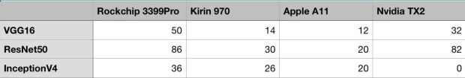
ASIC Performance Estimation
Max OPS: 2T for INT16, 8T for INT8, 32T for INT4
Without weight compression, DDR efficiency not considered
GoogleNet (1 frame needs 3.2GOPS)
2560 frame/s, 20GB/s DDR (8bit feature/weight)
10000 frame/s, 40GB/s DDR (4bit feature/weight)
Yolo v2 ( 1 frame 35GOPS)
228frame/s, 12.8GB/s (8bit feature/weight)
914frame/s, 25.6GB/s (4bit feature/weight)

Slide 6
DLA Feature List
Different 1/2/3D convolution layer
Direct/Image-input/Batching
Deconvolution
Atrous/dilated convolution
Hybrid precision MAC supporting INT16/8/4/2/binary
On-chip convolution buffer up to 2MB
Various activation layer
HW: ReLu/PReLu/Leaky ReLu/CReLu/RReLu/ReLu6
LUT: ELU/SELU/tanh/sigmoid
SW: softmax/softplus/softsign
Pooling (2D/3D)
Max/min/average with different stride
Local Response Normalization
Elementwise operation
Batch Normalization, scale, bias add

Slide 7
DLA Feature List to be done?
Winograd
Depthwise_conv2d
Pooling 3d
Dropout

Slide 8
Application System Diagram

Slide 9
DLA internal Architecture

Slide 10
Convolutional Buffer

Slide 11
MAC Array

Slide 12
SDP

Slide 13
PDP

Slide 14
CDP

Slide 15
SCU

Slide 16
软件相关议题
神经网络生成器
支持多种框架：tensorflow、tensorflow Lite、Caffe
DLA执行指令的生成
软件API
TEngine
Android NNAPI
Halide
中间表示层
LLVM （ Google XLA ）
NNVM/TVM

Slide 17
FPGA相关议题
Demo应用
人脸检测（Yolo/SSD），无人机
人脸识别（FaceNet/mobilenet），无人机
手势识别 (C3D fusion), 无人机
物体识别（Yolo、Google），无人机/扫地机

Slide 18
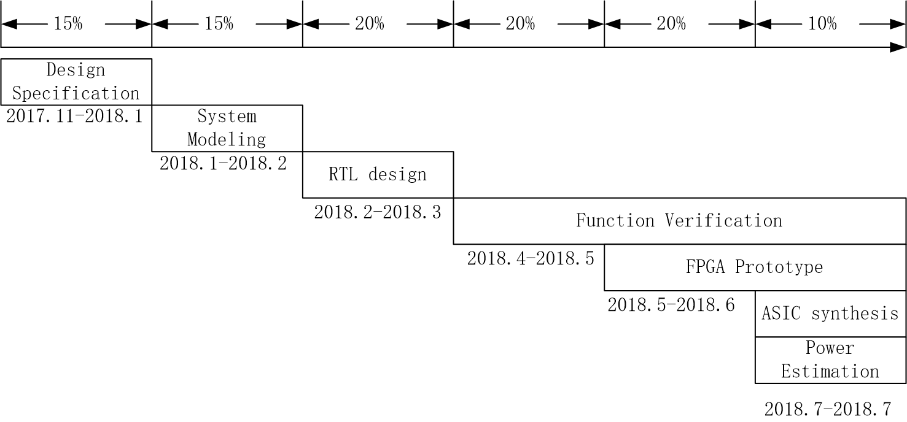
设计进度安排

Slide 19
数字前端设计流程
Design stage | Tools | Output
Design Specification | Word / excel /Visio | PDF file describes the system function and architecture
Algorithm modeling | Matlab / gcc/ VS | Documents describe the algorithms. C or matlab code
RTL design | Synplify / DC /Spyglass | Verilog HDL code
Function verification | VCS Veloce | RTL Test case list and the status of each test case Code coverage generated by VCS Code coverage generated by Veloce
FPGA prototype | Synplify/ Vivado QuartusII/ PlayerPro | FPGA test case list and the status of each test case
ASIC synthesis | DC / FM Conformal Spyglass | Netlist file ready for backend design Pass Formal verification Timing/area statistics Lint/CDC clear
Power estimation | VCS / PrimeTimePX | Average and peak power of typical application

